Slide 1
Advancing Equity
Training for Central Northeast Neighbors, Land Use and Transportation Committee (10/12/2016)
Trainers: Desirée Williams-Rajee, Equity Specialist (BPS)
Nan Stark, N/NE District Liaison (BPS)

Slide 2
GOALS
Build awareness of equity principles and practices
Develop tools that will support inclusive participation
Experience hands on practice applying an equity tool

Slide 3
Additional Ground rules
Learnings leave, names and stories stay
Share the air
Challenge yourself to be respectful of all each others’ feelings, perspectives, abilities, and identities (and your own)
Tend to impact
Be the expert of your experience, use “I” statements
Be okay with silence
Leave space for processing
Reserve the right to change your mind
…….

Slide 4
Brain warm-up
Pick a number between 1-10
Multiply by 9
If the resulting number is two digits, add those numbers together, e.g. 42 → 4 + 2 = 6
Subtract the 5 from that number
Find the letter in the alphabet that corresponds to that number
Think of a country that starts with that letter
Think of an animal that starts with the last letter of the country
Think of a fruit that starts with the last letter of the animal

Slide 5
Brain Science - BIAS
Video: https://www.youtube.com/watch?v=5eAwWMFZYbo

Slide 6
Discussion
Pair Discussion:
What kind of biases show up in land use and transportation processes and decision-making?
What types of perspectives does that miss?
Group discussion:
How can bias negatively impact the LUTOP, and what action can the group take to address it?

Slide 7
Privilege
Video: https://www.youtube.com/watch?v=qeYpvV3eRhY

Slide 8
Privilege Activity
Group Question: What are examples of privilege?

Slide 9
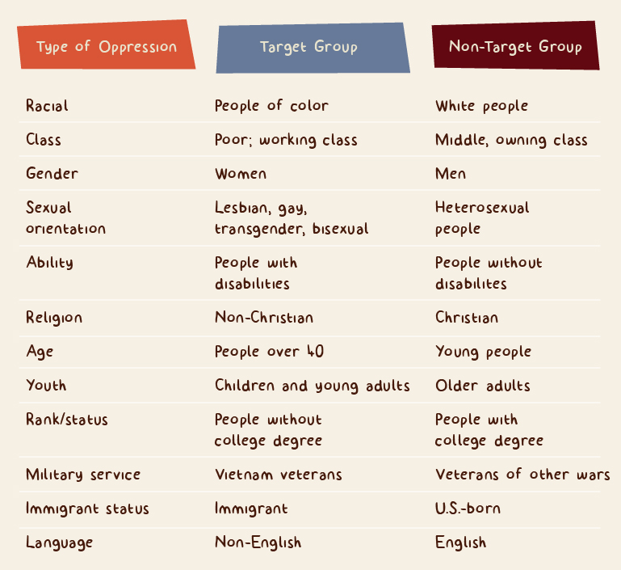
https://msw.usc.edu/mswusc-blog/diversity-workshop-guide-to-discussing-identity-power-and-privilege/

Slide 10
Privilege Activity
Self Reflection: With privilege – what is my responsibility?

Slide 11
Discussion
What are actions that we can take here to create more access for those who do not have privilege?

Slide 12
Inclusion and Participation
Handout Instructions:
Highlight the words and phrases that stand out to you

Slide 13
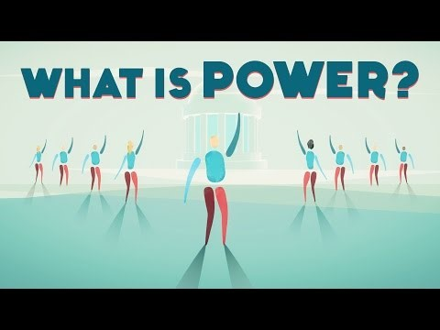
PoWEr
Video: http://ed.ted.com/lessons/how-to-understand-power-eric-liu

Slide 14
Discussion
Questions:
What is the power that representatives of the LUTOP have, and what can intentionally be done to ensure that it is used to support the goals of the Inclusion and Participation?
How do you increase people’s power to participate considering equity and inclusion?

Slide 15
BREAK

Slide 16
What is equity

Slide 17
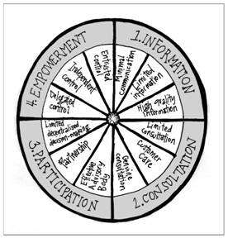
Defining Equity
Procedural Equity: Ensuring that processes are fair and inclusive in the development and implementation of any program or policy.

Slide 18
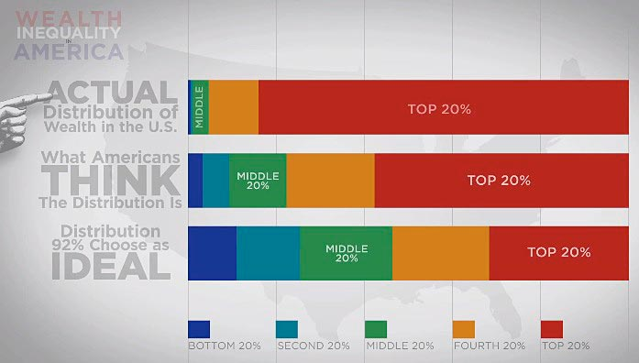
Defining Equity
Distributional Equity: Ensuring that resources or benefits and burdens of a policy or program are distributed fairly, prioritizing those with highest need first.
From: Wealth Inequality in America: http://www.youtube.com/watch?v=QPKKQnijnsM

Slide 19
Defining Equity
Structural (Intergenerational) Equity: A commitment and action to correct past harms and prevent future negative consequences by institutionalizing accountability and decision-making structures that aim to sustain positive outcomes.

Slide 20
Activity
Draw a box using three rows of dots that looks like this:
Using one line, connect all the dots.

Slide 21
Equity Lens

Slide 22
Equity Empowerment Lens – Mult Co
People
Place
Process
Power
Purpose

Slide 23
Activity
In your group, assess the policy using one component of the equity lens.

Slide 24
Closing
What will you take away from this training?

