Slide 1
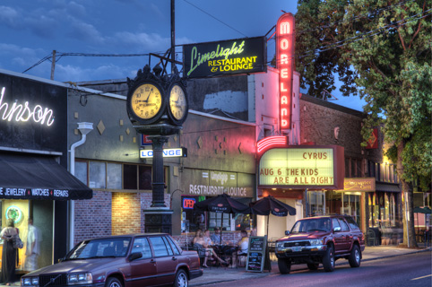
Land Use Training
SMILE
July 15, 2015
Notes:
Introduce yourself and why you are here tonight

Slide 2
Objectives
Understand role of neighborhood associations in land use
Become familiar with best practices with land use notices
Discuss long-range planning & advocacy opportunities
Inspire thought/discussion about SMILE’s land use

Slide 3
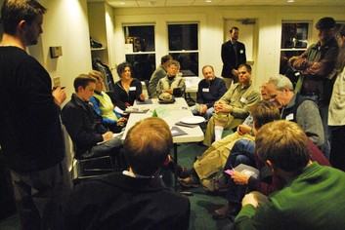
What is SMILE’s Role in Land Use?
Convener of neighbors
Distributor of information
Forum for development meetings
Advocates
Source of ideas
“Recognized organization”
Notes:
Brainstorm NA’s role in land use

Slide 4
How are you recognized?
Land Use Review Process
Notices and decisions
Some fees waived
Comments may be afforded greater weight
Neighborhood contact
Certain types of land divisions
Historic and design zones
Resources
BPS District Liaison
SE Uplift staff
Notes:
Additionally, you often get a seat at the table

Slide 5
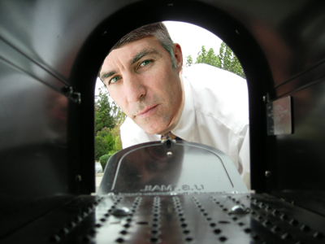
Notification, you say?
Notes:
Frequently hear from neighbors that they didn’t hear about a development. Why is that the case?

Slide 6
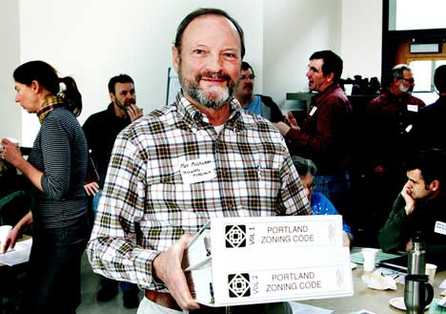
When are you not notified
Most non-discretionary reviews
Building Permits
Zoning Permits
Mechanical permits
Lot confirmations & property line adjustments
Development that is allowed “by right”
Notes:
By-right development is allowed in the zoning code. Doesn’t require any adjustments or changes. No provision for notification in most cases.

Slide 7
When are you notified?

Slide 8
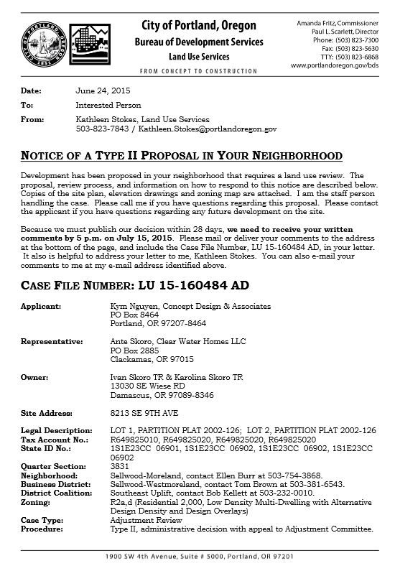
Discretionary Reviews
Adjustments
Conditional Uses
Design/Historic Review
Environmental Review
Land Divisions
Zone Changes
Notes:
Discretionary reviews are “quasi-judicial”. They are sent to the NA and to property owners within a certain distance of the property. They allow for public comments. Can be appealed to LUBA, hearings officer or City Council. SMILE has LUC rules in place.

Slide 9
How can SMILE respond?
Distribute information
Help concerned neighbors navigate the process
Convene stakeholders for a discussion
Take a position as a board
Written testimony
Testimony at hearings
Appeal
Notes:
Include a bit about SMILE’s land use committee. It is also OK NOT to respond or to respond with positive thoughts about a project.

Slide 10
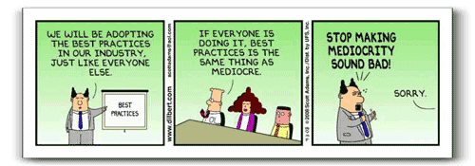
Best practices
Gather as much information as possible
Invite all stakeholders before making a decision
Follow open meeting laws
Testimony
Speak to the approval criteria
Facts are stronger than feelings (except w/ politicians!)

Slide 11
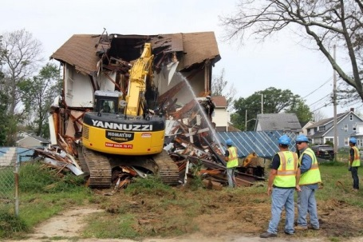
Demolition Notification
35-day delay on all single family demolitions in residential zones
Possibility for further 60-day demolition delay
Delay request must show:
Attempt to contact property owner
Significance of property to neighborhood
Plan to save the structure
A Pro-forma budget and evidence of funds/fundraising plan
Hearings Officer rules on delay request

Slide 12
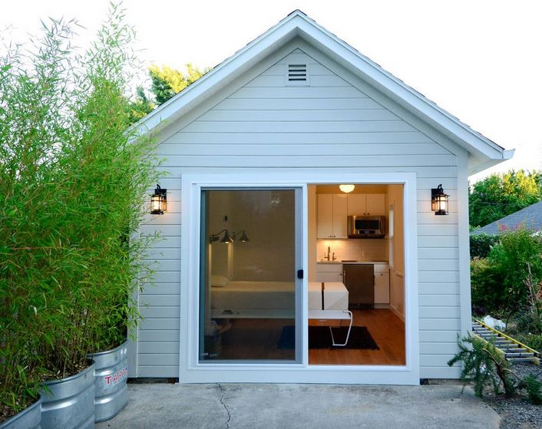
Other notifications
Major alterations and additions
Short-term rentals
Liquor licenses
Other bureaus
Notes:
Airbnb listing in SMILE $85/night

Slide 13
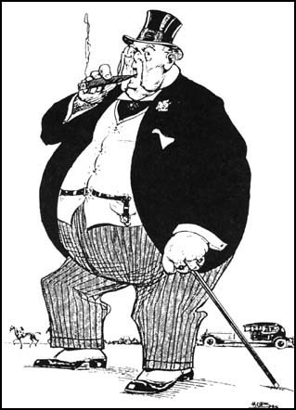
Meeting with developers
Gather and distribute information ahead of time
Provide questions to developer in advance
Invite all impacted parties
Establish guidelines and follow them
Set a respectful tone
Don’t let a few voices dominate
Designate a point person for follow up
Be realistic with your expectations
& requests

Slide 14
Halftime
Notes:
When did the Moreland Theater open? 1926 presented vaudeville acts with silent films

Slide 15
Long-range Planning

Slide 16
Long-range planning

Slide 17
Comprehensive Plan

Slide 18
Comprehensive Plan
20-year growth plan for the city
Policies and infrastructure system priorities
Two map system
Designation map: What is envisioned for future
Zoning map: What can be built today
Changes to underlying zoning
Mixed Use sites
Colleges/hospitals
Notes:
The two maps are largely aligned. Occasionally sites will have different designation than current zoning

Slide 19
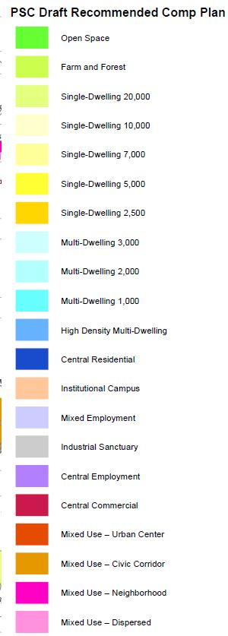
Notes:
Comprehensive Plan designation map – Vast majority of SMILE remains unchanged

Slide 20
Notes:
Downzoning near light rail station and on the bluff. Purple reflects the new zoning for commercial areas – will be similar to what is allowed today. Southern part of 13th downzoned from EX per SMILE request.

Slide 21
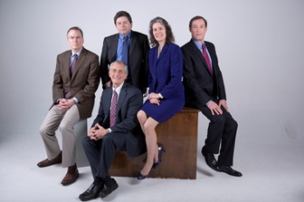
Avenues for board participation
Policies, goals, and designation map in front of City Council
Testimony: August -> Fall hearings
Mixed Use Zoning
Released in August
PSC hearings in October/November
City Council hearings in late winter
Zoning Map
Released in September
PSC hearings in late winter
City Council hearings in 2016

Slide 22
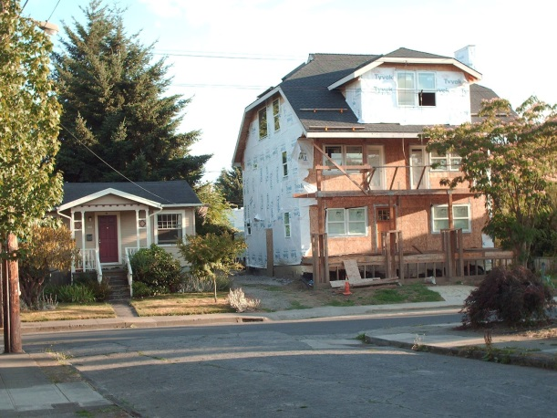
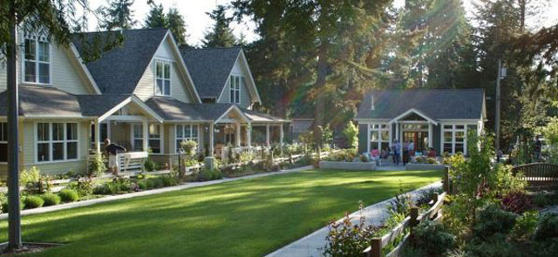
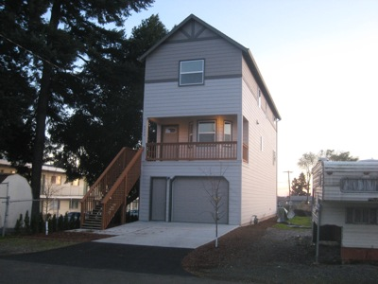
Residential Infill Project
Scale of houses
Narrow houses/lots
Alternative housing options
Notes:
18-month project. Deadline to apply for the Stakeholder Advisory Committee is August 7.

Slide 23
Resources, Resources, Resources
PortlandMaps.com
Notices, Hearings, Decisions: http://www.portlandoregon.gov/bds/36652
Zoning code hotline: (503) 823-PLAN (7526)
Marty Stockton, BPS District Liaison: marty.stockton@portlandoregon.gov, (503) 823-2041
Comprehensive Plan hotline: (503) 823-0195
Resolutions Northwest
ABCs of Land Use Training
SE Uplift Land Use and Transportation Committee (3rd Monday of month 7-9pm at 3534 SE Main)

Slide 24
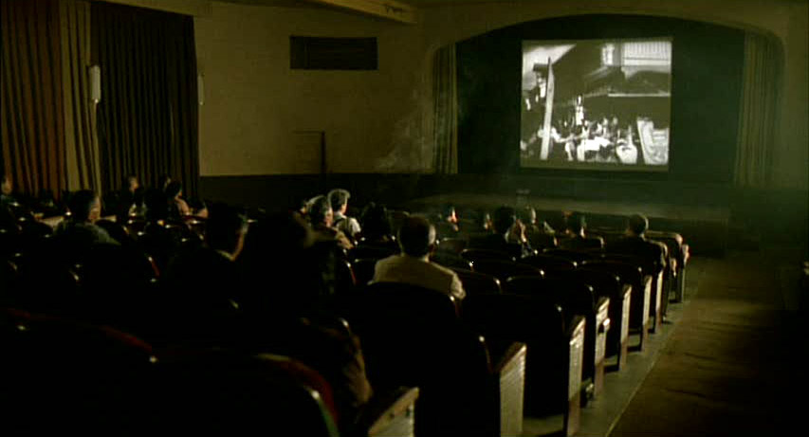
Thank you
Bob Kellett
bob@seuplift.org
(503) 232-0010 ext. 314

